Slide 1
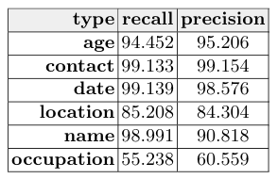




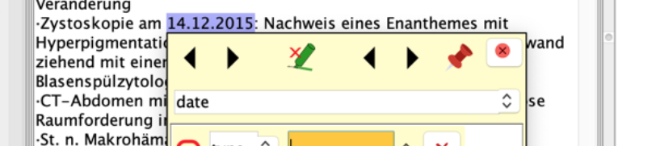
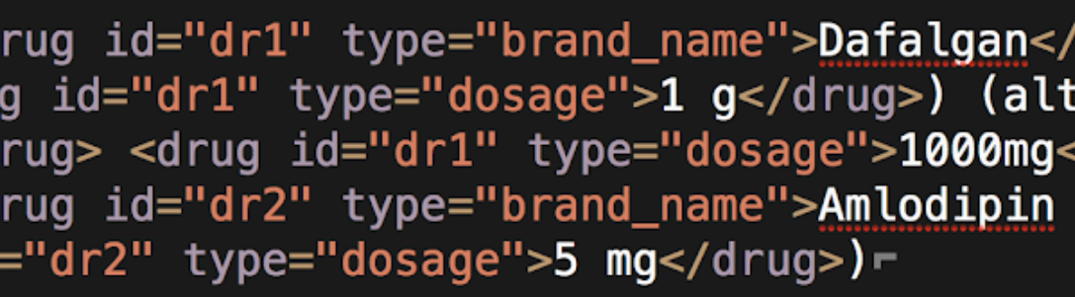



Automated ADE detection from electronic medical records using NLP
Data Extraction
Anonymization (per category)
SwissMADE is the first Swiss project to use electronic patient records. We employed the dictionary-based entity recognizer OGER to extract drug and diagnose mentions.
Reports from patients who received antithrombotic drugs during hospital stay in one of the four hospitals below longer than 24 hours, aged 65 and older, between 2015 and 2016.
automated detection of adverse drug events from older patients’ electronic medical records using text mining
The paper describes the processing of 18 000 reports extracted from the University Hospital of Zurich (USZ).
Automatic Annotation
Manual Annotation
From structured patient data, dictionaries are generated of of drug and diagnose variations. These dictionaries are used by OGER to automatically annotate free text data.
400 reports are automatically annotated by the Kantonsspital Baden (KSB) using the GATE annotation tool and a schema developed by all four hospitals together.
This data set will serve as an evaluation for our pipeline.
nicola.colic@uzh.ch, Beeler, Csajka, Foufi, Gaspar, Le Pogam, Lisibach, Lovis, Lutters, Rinaldi
check the QR code for the full paper and full list of associations

Slide 2
Automated ADE detection from electronic medical records using NLP
Data Extraction
Anonymization (per category)
SwissMADE is the first Swiss project to use electronic patient records. We employed the dictionary-based entity recognizer OGER to extract drug and diagnose mentions.
Reports from patients who received antithrombotic drugs during hospital stay in one of the four hospitals below longer than 24 hours, aged 65 and older, between 2015 and 2016.
The paper describes the processing of 18 000 reports extracted from the University Hospital of Zurich (USZ).
Automatic Annotation
Manual Annotation
From structured patient data, dictionaries are generated of of drug and diagnose variations. These dictionaries are used by OGER to automatically annotate free text data.
400 reports are automatically annotated by the Kantonsspital Baden (KSB) using the GATE annotation tool and a schema developed by all four hospitals together.
This data set will serve as an evaluation for our pipeline.
nicola.colic@uzh.ch, Beeler, Csajka, Foufi, Gaspar, Le Pogam, Lisibach, Lovis, Lutters, Rinaldi
check the QR code for the full paper and full list of associations

Slide 3
Automated ADE detection from electronic medical records using NLP
SwissMADE an SNF-funded collaboration of 4 Swiss hospitals, who provide the patient data, and a variety of research groups in the German and French speaking part of Switzerland who process the data
Hospitals
University Hospital Zurich
University Hospital Lausanne
Geneva University Hospitals
Cantonal Hospital Baden
Research Groups
Department of Computational Linguistics, University of Zurich
Dalle Molle Institute for Artificial Intelligence Research
Swiss Institue of Bioinformatics
Center for Research and Innovation in Clinical Pharmacy Sciences, University of Lausanne
Institute of Pharmaceutical Sciences, University of Geneva
Data Extraction
Anonymization (per category)
SwissMADE is the first Swiss project to use electronic patient records. We employed the dictionary-based entity recognizer OGER to extract drug and diagnose mentions.
Reports from patients who received antithrombotic drugs during hospital stay in one of the four hospitals below longer than 24 hours, aged 65 and older, between 2015 and 2016.
The paper describes the processing of 18 000 reports extracted from the University Hospital of Zurich (USZ).
Automatic Annotation
Manual Annotation
From structured patient data, dictionaries are generated of of drug and diagnose variations. These dictionaries are used by OGER to automatically annotate free text data.
400 reports are automatically annotated by the Kantonsspital Baden (KSB) using the GATE annotation tool and a schema developed by all four hospitals together.
This data set will serve as an evaluation for our pipeline.
nicola.colic@uzh.ch, Beeler, Csajka, Foufi, Gaspar, Le Pogam, Lisibach, Lovis, Lutters, Rinaldi
check the QR code for the full paper and full list of associations

Slide 4
Automated ADE detection from electronic medical records using NLP
SwissMADE an SNF-funded collaboration of 4 Swiss hospitals, who provide the patient data, and a variety of research groups in the German and French speaking part of Switzerland who process the data
Hospitals
University Hospital Zurich
University Hospital Lausanne
Geneva University Hospitals
Cantonal Hospital Baden
Research Groups
Department of Computational Linguistics, University of Zurich
Dalle Molle Institute for Artificial Intelligence Research
Swiss Institue of Bioinformatics
Center for Research and Innovation in Clinical Pharmacy Sciences, University of Lausanne
Institute of Pharmaceutical Sciences, University of Geneva
Data Extraction
Anonymization (per category)
SwissMADE is the first Swiss project to use electronic patient records. We employed the dictionary-based entity recognizer OGER to extract drug and diagnose mentions.
Reports from patients who received antithrombotic drugs during hospital stay in one of the four hospitals below longer than 24 hours, aged 65 and older, between 2015 and 2016.
The paper describes the processing of 18 000 reports extracted from the University Hospital of Zurich (USZ).
Automatic Annotation
Manual Annotation
From structured patient data, dictionaries are generated of of drug and diagnose variations. These dictionaries are used by OGER to automatically annotate free text data.
400 reports are automatically annotated by the Kantonsspital Baden (KSB) using the GATE annotation tool and a schema developed by all four hospitals together.
This data set will serve as an evaluation for our pipeline.
nicola.colic@uzh.ch, Beeler, Csajka, Foufi, Gaspar, Le Pogam, Lisibach, Lovis, Lutters, Rinaldi
check the QR code for the full paper and full list of associations

Slide 5
Automated ADE detection from electronic medical records using NLP
Since the SwissMADE project was the first of its kind in Switzerland, extraction and anonymization of patient data was not trivial and took up over a year.
Data Extraction
Anonymization (per category)
SwissMADE is the first Swiss project to use electronic patient records. We employed the dictionary-based entity recognizer OGER to extract drug and diagnose mentions.
Reports from patients who received antithrombotic drugs during hospital stay in one of the four hospitals below longer than 24 hours, aged 65 and older, between 2015 and 2016.
The paper describes the processing of 18 000 reports extracted from the University Hospital of Zurich (USZ).
Automatic Annotation
Manual Annotation
From structured patient data, dictionaries are generated of of drug and diagnose variations. These dictionaries are used by OGER to automatically annotate free text data.
400 reports are automatically annotated by the Kantonsspital Baden (KSB) using the GATE annotation tool and a schema developed by all four hospitals together.
This data set will serve as an evaluation for our pipeline.
nicola.colic@uzh.ch, Beeler, Csajka, Foufi, Gaspar, Le Pogam, Lisibach, Lovis, Lutters, Rinaldi
check the QR code for the full paper and full list of associations

Slide 6
Automated ADE detection from electronic medical records using NLP
At USZ, the SwissMADE project was the first stakeholder for an independent project aimed at automatically anonymizing patient reports. The system developed there uses manually crafted rules to detect and replace PHI to hide them in plain sight.
Anonymization (per category)
Data Extraction
SwissMADE is the first Swiss project to use electronic patient records. We employed the dictionary-based entity recognizer OGER to extract drug and diagnose mentions.
Reports from patients who received antithrombotic drugs during hospital stay in one of the four hospitals below longer than 24 hours, aged 65 and older, between 2015 and 2016.
The paper describes the processing of 18 000 reports extracted from the University Hospital of Zurich (USZ).
Automatic Annotation
Manual Annotation
From structured patient data, dictionaries are generated of of drug and diagnose variations. These dictionaries are used by OGER to automatically annotate free text data.
400 reports are automatically annotated by the Kantonsspital Baden (KSB) using the GATE annotation tool and a schema developed by all four hospitals together.
This data set will serve as an evaluation for our pipeline.
nicola.colic@uzh.ch, Beeler, Csajka, Foufi, Gaspar, Le Pogam, Lisibach, Lovis, Lutters, Rinaldi
check the QR code for the full paper and full list of associations

Slide 7
Automated ADE detection from electronic medical records using NLP
The USZ reports have a structured and a free text section. We extracted from the structured sections all drug names and diagnoses to generate a dictionary. This dictionary we use with OGER, our entity recognizer, to find drugs and diagnose mentions in the free text sections.
Data Extraction
Anonymization (per category)
SwissMADE is the first Swiss project to use electronic patient records. We employed the dictionary-based entity recognizer OGER to extract drug and diagnose mentions.
Reports from patients who received antithrombotic drugs during hospital stay in one of the four hospitals below longer than 24 hours, aged 65 and older, between 2015 and 2016.
The paper describes the processing of 18 000 reports extracted from the University Hospital of Zurich (USZ).
Automatic Annotation
Manual Annotation
From structured patient data, dictionaries are generated of of drug and diagnose variations. These dictionaries are used by OGER to automatically annotate free text data.
400 reports are automatically annotated by the Kantonsspital Baden (KSB) using the GATE annotation tool and a schema developed by all four hospitals together.
This data set will serve as an evaluation for our pipeline.
nicola.colic@uzh.ch, Beeler, Csajka, Foufi, Gaspar, Le Pogam, Lisibach, Lovis, Lutters, Rinaldi
check the QR code for the full paper and full list of associations

Slide 8
Automated ADE detection from electronic medical records using NLP
In previous research we could show that using OGER together with BioBERT models trained on the CRAFT corpus attains state of the art performance. OGER in this case provides IDs for spans detected by the models.
Data Extraction
Anonymization (per category)
SwissMADE is the first Swiss project to use electronic patient records. We employed the dictionary-based entity recognizer OGER to extract drug and diagnose mentions.
Reports from patients who received antithrombotic drugs during hospital stay in one of the four hospitals below longer than 24 hours, aged 65 and older, between 2015 and 2016.
The paper describes the processing of 18 000 reports extracted from the University Hospital of Zurich (USZ).
Automatic Annotation
Manual Annotation
From structured patient data, dictionaries are generated of of drug and diagnose variations. These dictionaries are used by OGER to automatically annotate free text data.
400 reports are automatically annotated by the Kantonsspital Baden (KSB) using the GATE annotation tool and a schema developed by all four hospitals together.
This data set will serve as an evaluation for our pipeline.
Furrer, L., Cornelius, J., Rinaldi, F.: UZH@CRAFT-ST: a sequence-labeling approach to concept recognition. In: Proceedings of The 5th Workshop on BioNLPOpen Shared Tasks. pp. 185–195 (2019)
nicola.colic@uzh.ch, Beeler, Csajka, Foufi, Gaspar, Le Pogam, Lisibach, Lovis, Lutters, Rinaldi
check the QR code for the full paper and full list of associations

Slide 9
Automated ADE detection from electronic medical records using NLP
In order to evaluate our performance and make similar efforts in other research groups comparable across the project, we iteratively developed an annotation schema. From the 18 000 USZ reports, 400 reports were selected for manual annotation using GATE by a medical expert at KSB.
Anonymization (per category)
Data Extraction
SwissMADE is the first Swiss project to use electronic patient records. We employed the dictionary-based entity recognizer OGER to extract drug and diagnose mentions.
Reports from patients who received antithrombotic drugs during hospital stay in one of the four hospitals below longer than 24 hours, aged 65 and older, between 2015 and 2016.
The paper describes the processing of 18 000 reports extracted from the University Hospital of Zurich (USZ).
Automatic Annotation
Manual Annotation
From structured patient data, dictionaries are generated of of drug and diagnose variations. These dictionaries are used by OGER to automatically annotate free text data.
400 reports are automatically annotated by the Kantonsspital Baden (KSB) using the GATE annotation tool and a schema developed by all four hospitals together.
This data set will serve as an evaluation for our pipeline.
nicola.colic@uzh.ch, Beeler, Csajka, Foufi, Gaspar, Le Pogam, Lisibach, Lovis, Lutters, Rinaldi
check the QR code for the full paper and full list of associations

